Slide 1
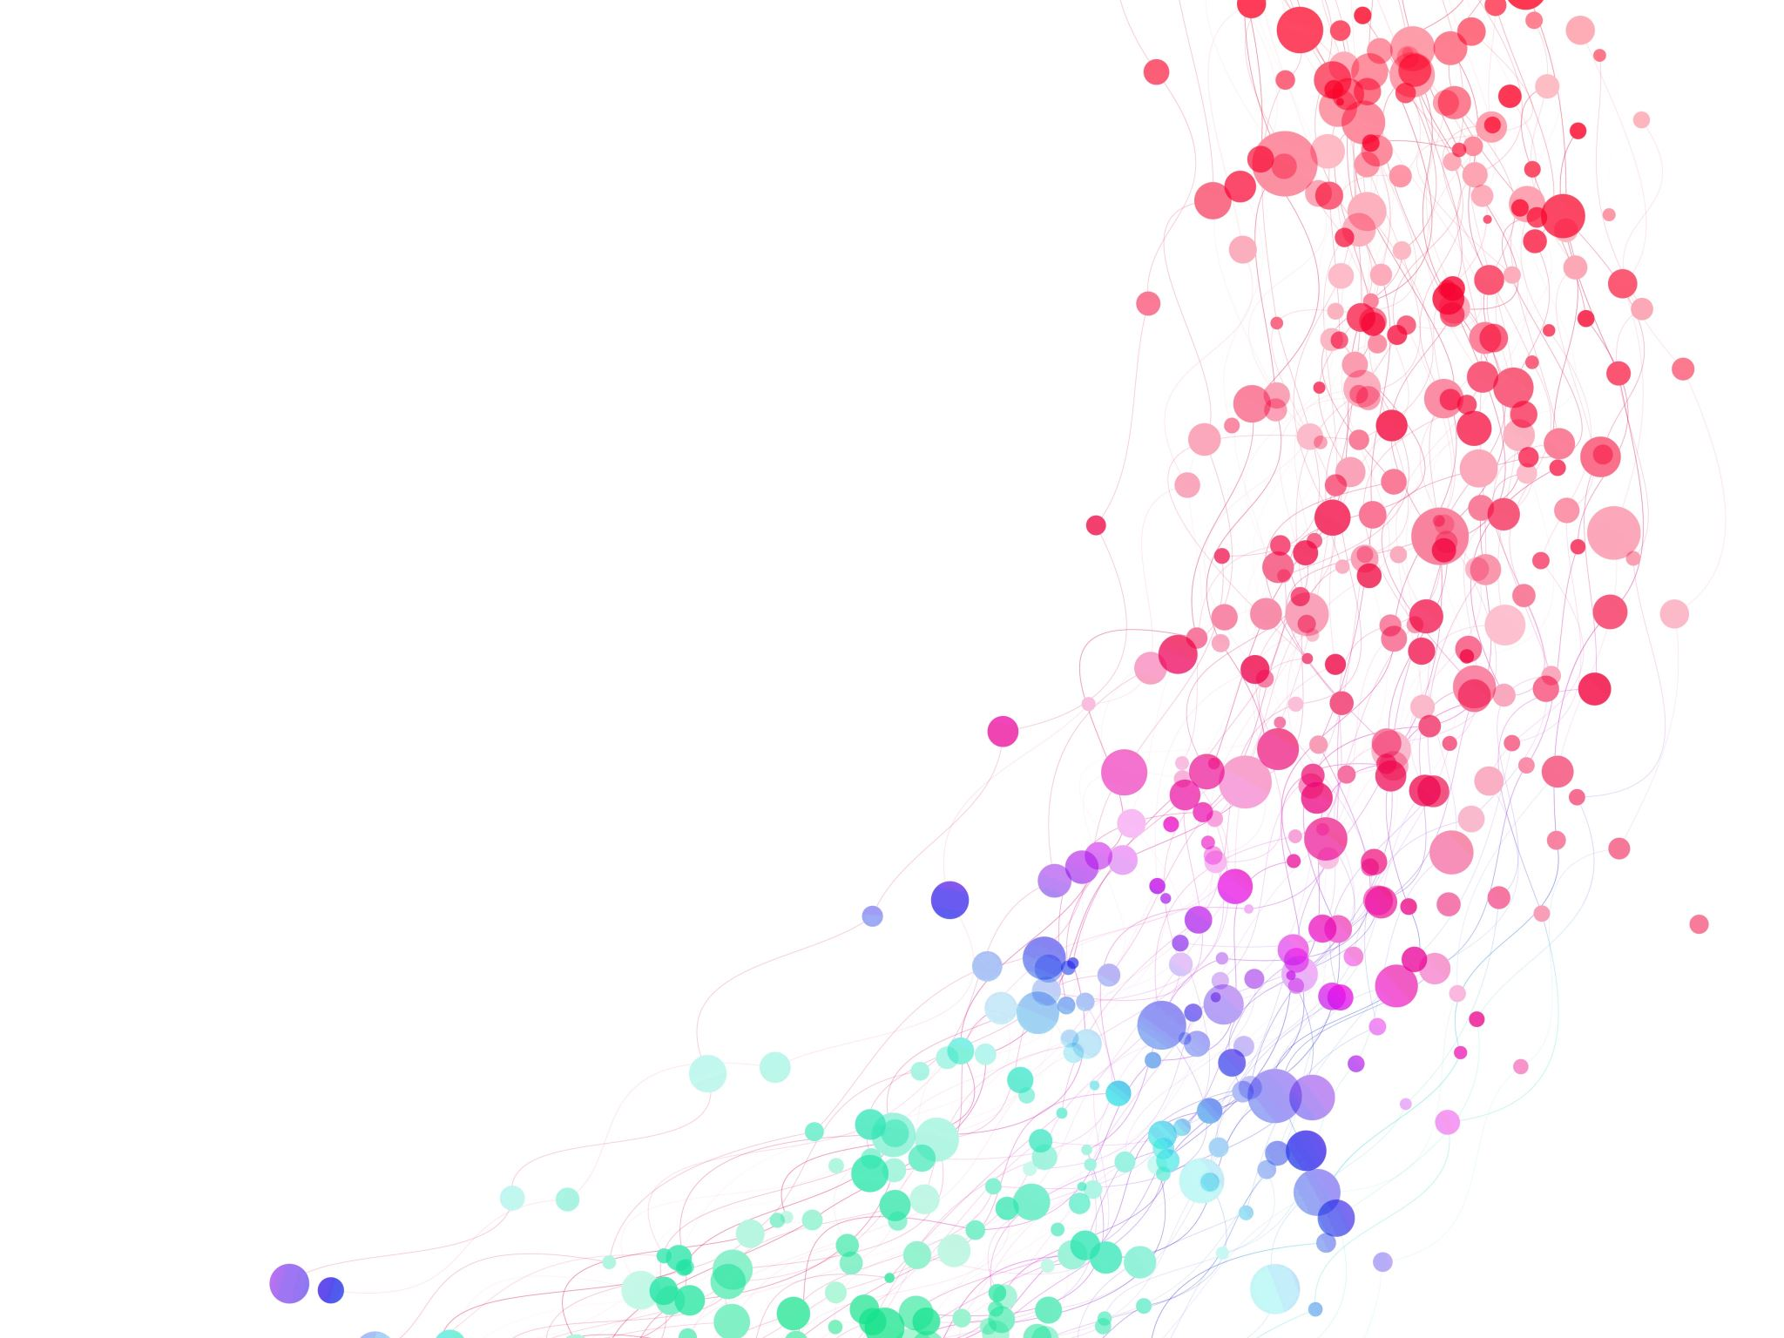
PsychoPy Tutorial
By Alexander Mervar and Jenna Bunner

Slide 2
Function of PsychoPy:
PsychoPy is used for experiments in psychology, cognitive neuroscience and many other labs.
PsychoPy has a large variety of stimuli in order to generate experiments such as random dots, shapes, sounds, and text.
PsychoPy allows for a wide range of experiments to be created. Experiments using a keyboard, or a textbox can create endless opportunities for experiments.

Slide 3
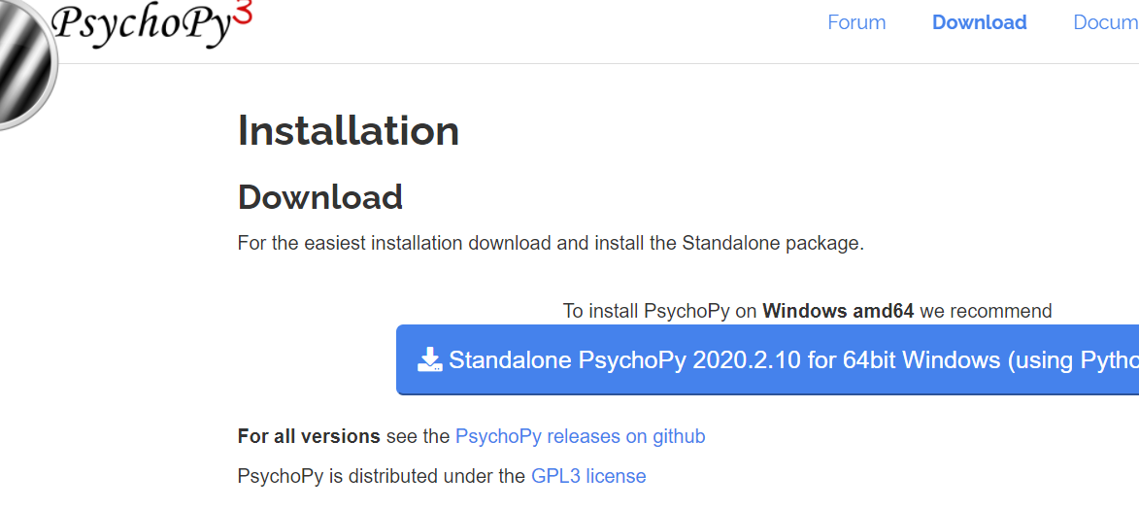
How to install PsychoPy:
Personally, I would just install this stand alone package. It will download on your computer and you will just need to start the app.

Slide 4
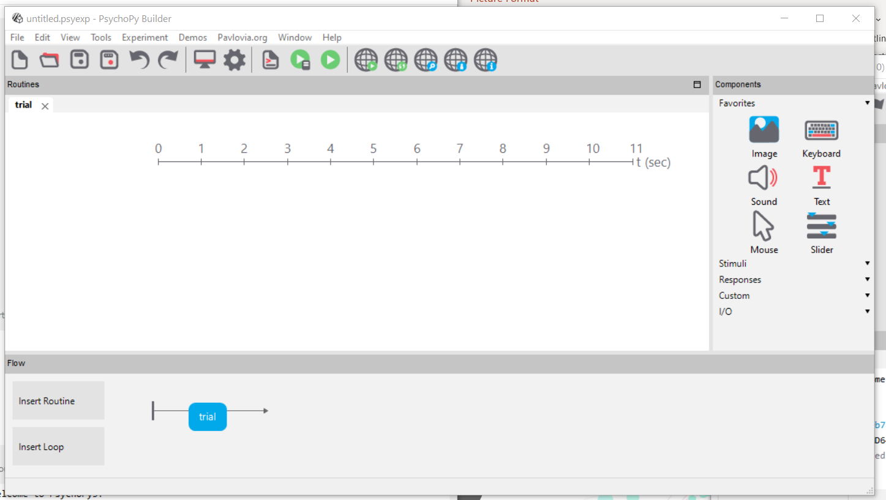
In PsychoPy you can either code in python or you can use the PsychoPy builder that helps build your experiment minus a typical code in python.

Slide 5
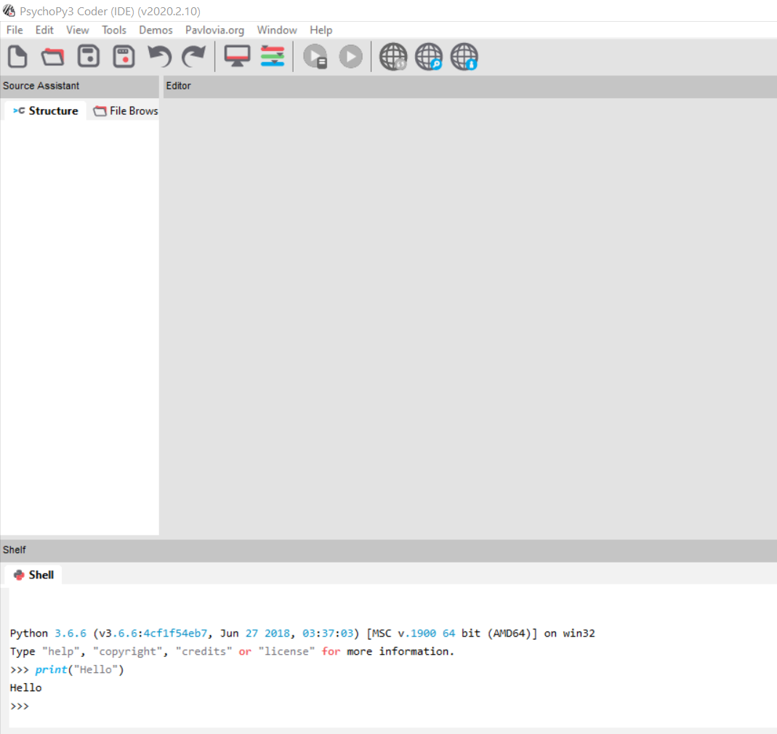
This is what the coding screen would look like. You would just type in the “shell” portion of the screen just as I did with “Hello”.

Slide 6
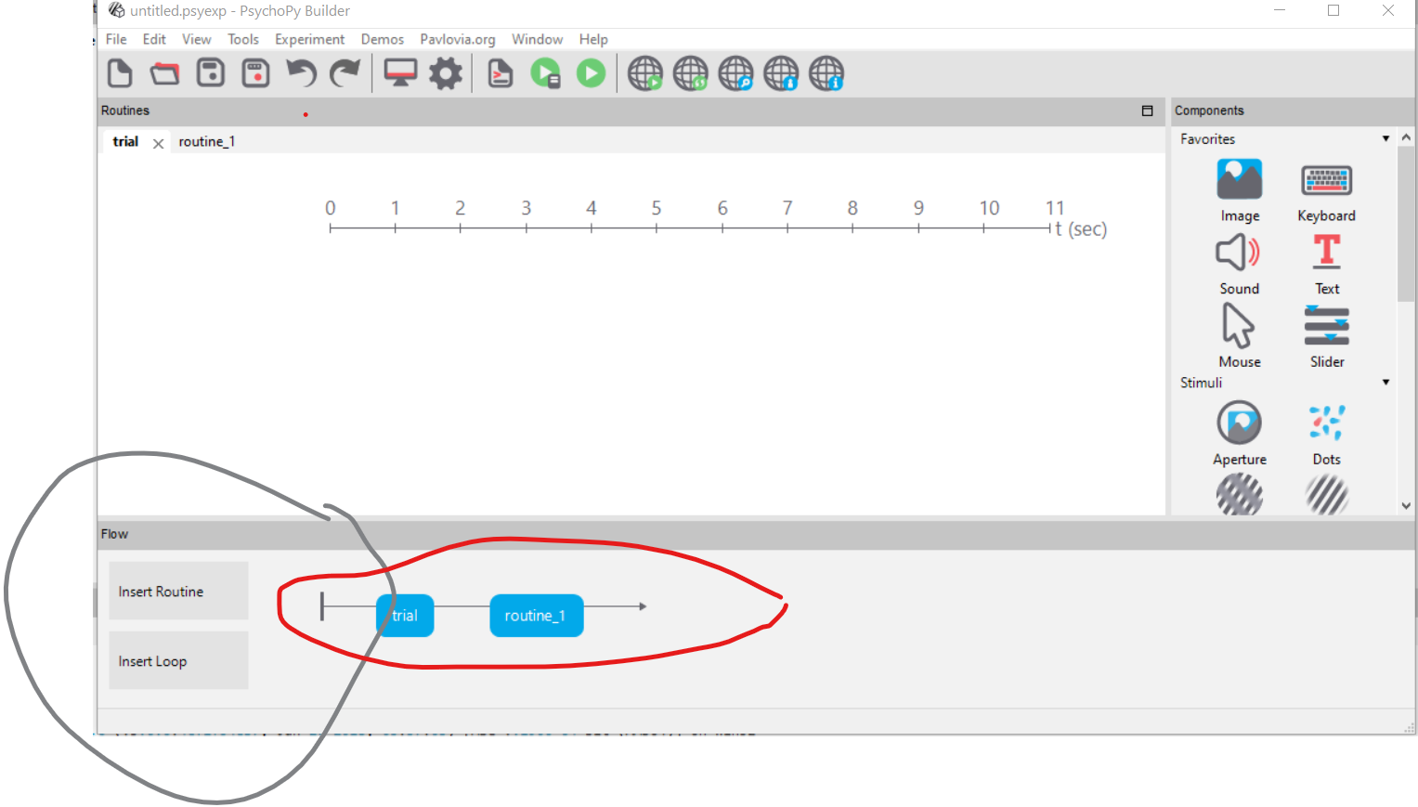
In the same location that the insert routine is in, you can insert a loop. Once you click the insert loop, similarly to the routine, you will pick a location in the red circled area for your loop to go. For example, if you’d like the trial window to loop you would put it before and after the blue trial button. A window will pop up prompting you to write conditions and repetitions.

Slide 7
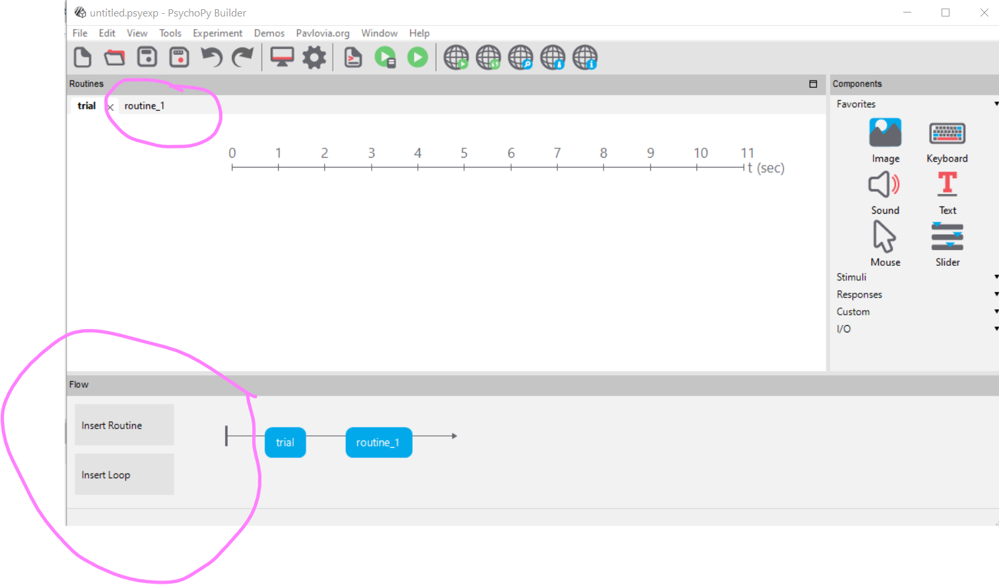
In order to add different windows throughout your experiment, you will go down in the bottom left of the screen and click insert routine. Once you do this you need to select the order in which you want the windows to appear. There you will click new and it will then create a new window that will appear in the upper left part of the screen.

Slide 8
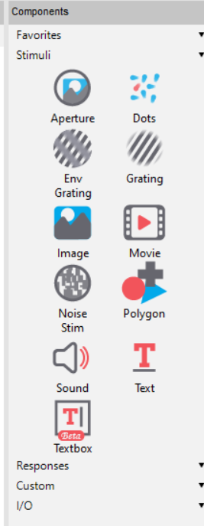
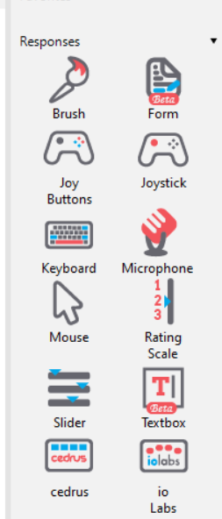
Creating an Experiment in PsychoPy
PsychoPy allows you to use different stimuli in your experiment; one can use dots, images, text, sound , etc.
PsychoPy also allows you to use different methods for responses in your particular experiment. You might want to create an experiment using the keyboard or a textbox.

Slide 9
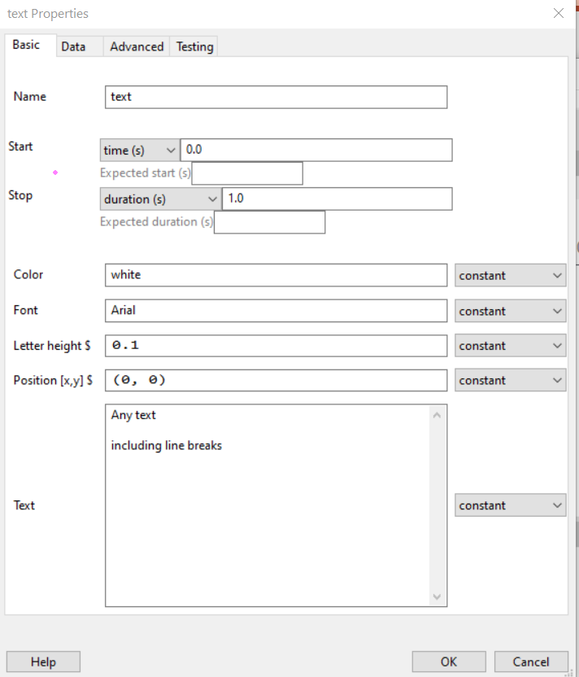
In this text box, you can manipulate how long your stimuli stays on the screen. For example, in name, you can type a name for this piece that you would like to present. You will type the text that you want displayed in the last large box. You will start and at the second that you want the stimulus to appear and disappear on the screen. For color, you can type a color etc.

Slide 10
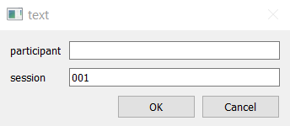
When you go to run your code, it will have you type in something in the participant. It would be your name or a number you were assigned since the goal of PsychoPy is to create experiments.

Slide 11
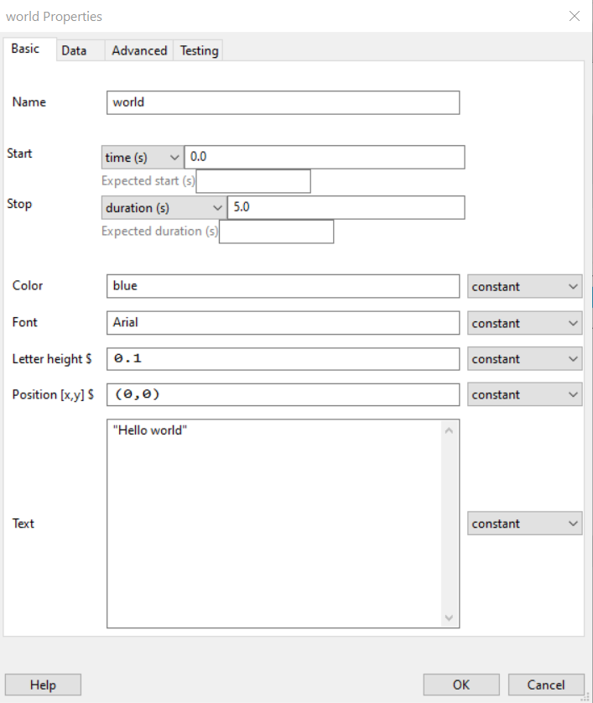
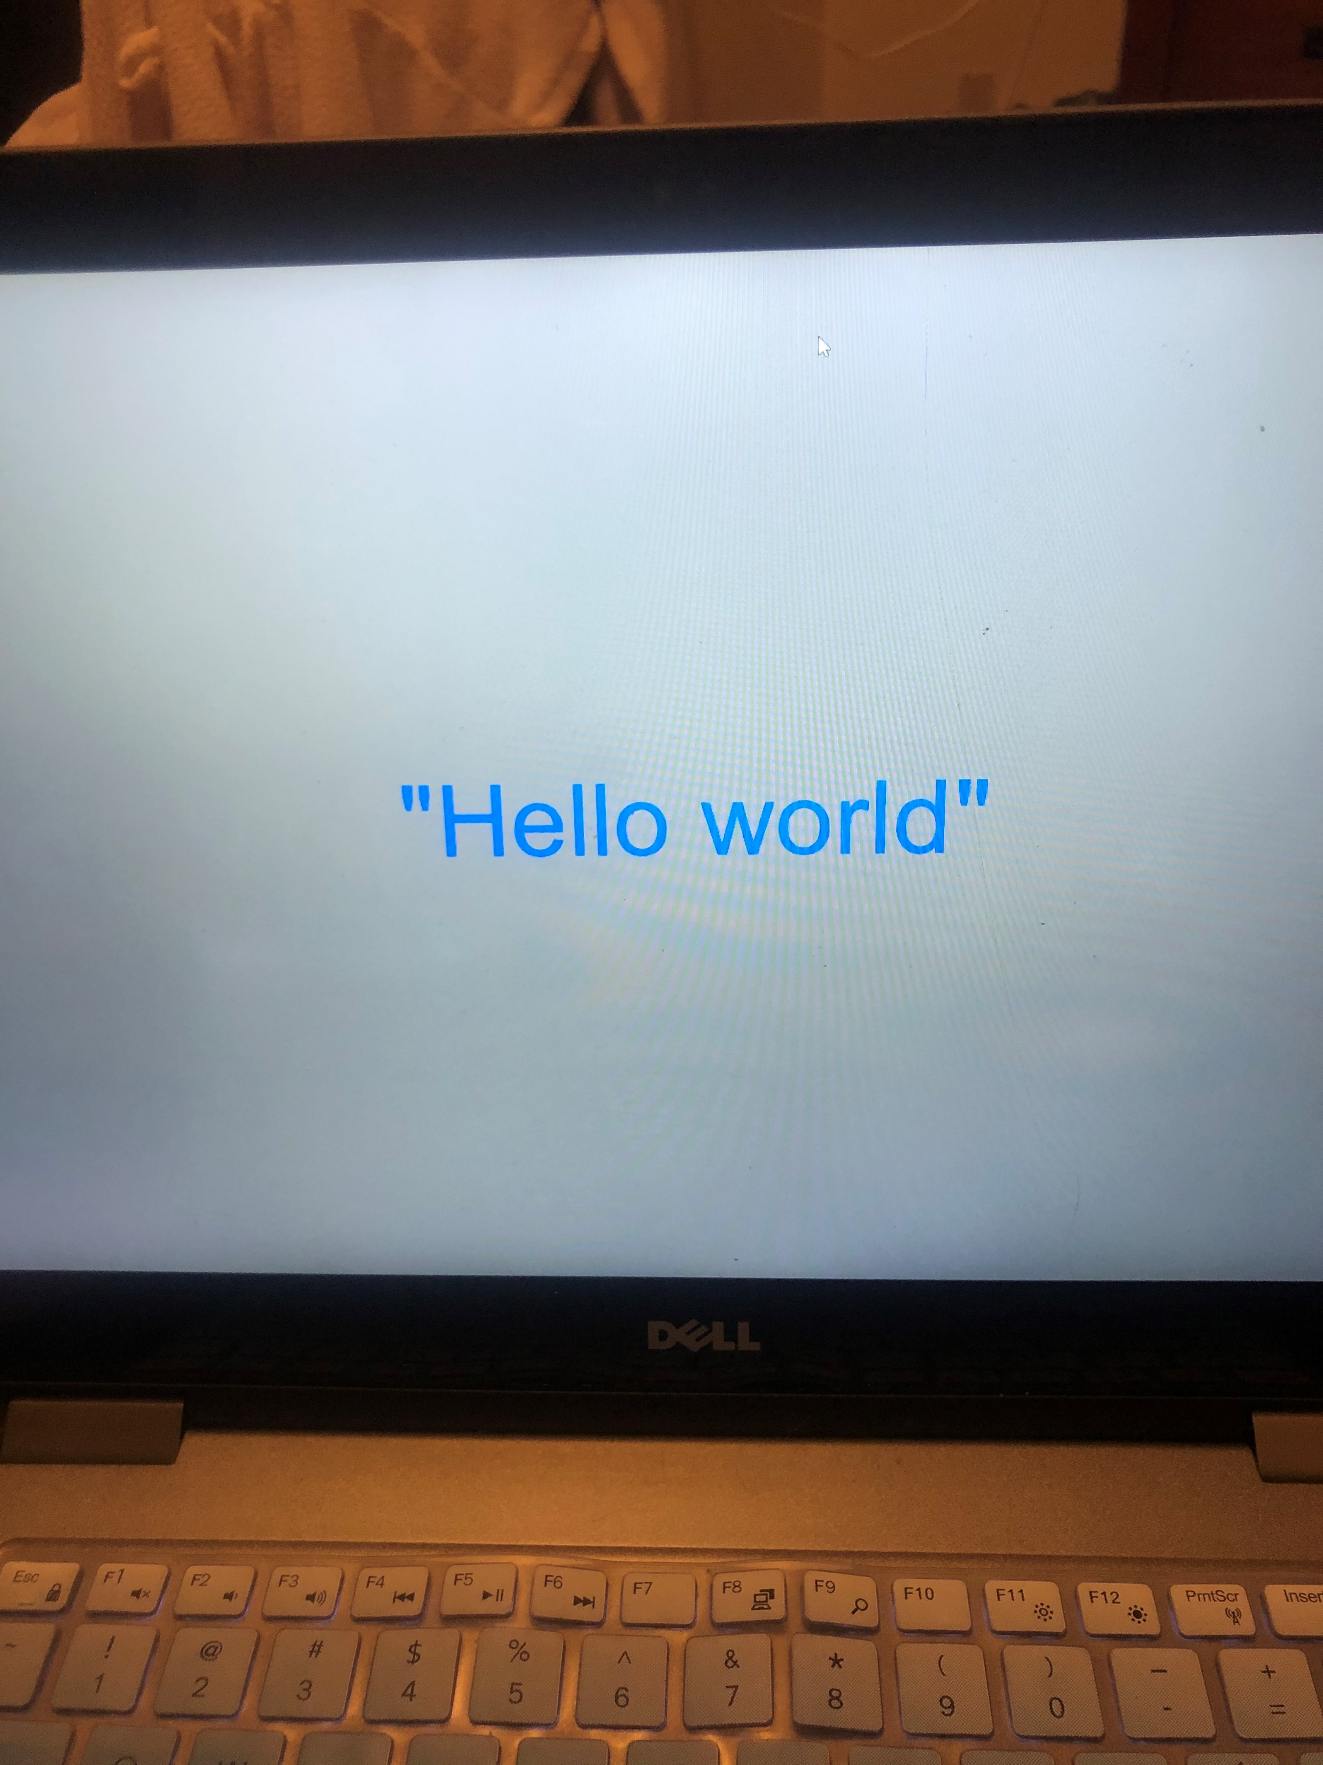
You can create a simple code through the PsychoPy builder just like this.

Slide 12

Recorded Code from Alexander

